Slide 1
CS-773 Paper Presentation Improving the Utilization of Micro-operation Caches in x86 Processors
Sumon Nath Hyperthreads(#6) sumon@cse.iitb.ac.in
Some of the figures are adapted and modified from the paper

Slide 2
Coming up
Background - Micro op cache
Impact of Micro op cache
Motivation - Micro op cache inefficiency
Solutions proposed
Conclusion

Slide 3
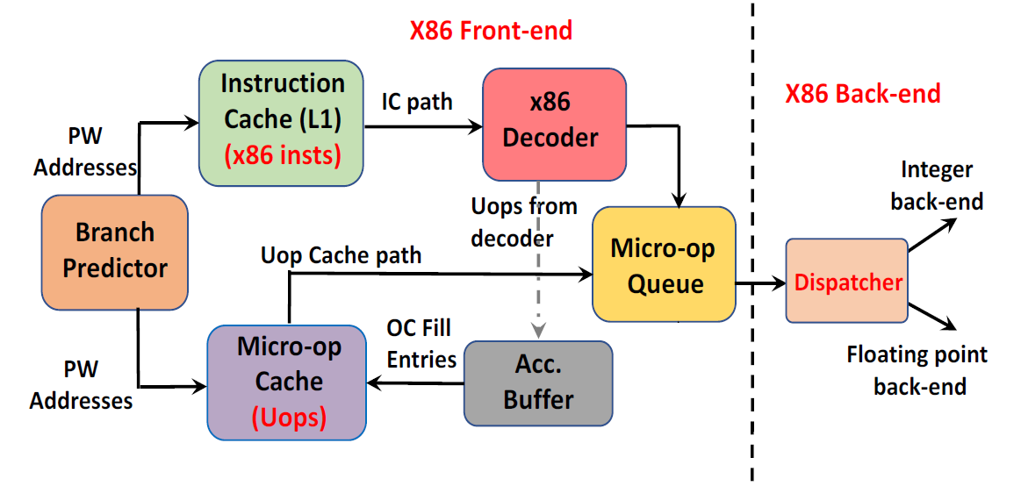
Background: CPU frontend

Slide 4
Background: CPU frontend
Range of address ~ basic block

Slide 5
Background: CPU frontend
Power hungry decoder -> Variable length ISA

Slide 6
Background: CPU frontend
Fixed length micro-op(uop) -> simpler execution logic

Slide 7
Background: CPU frontend
Uops cached into uop cache

Slide 8
Background: CPU frontend
Hit uop cache -> bypass fetch & decode

Slide 9
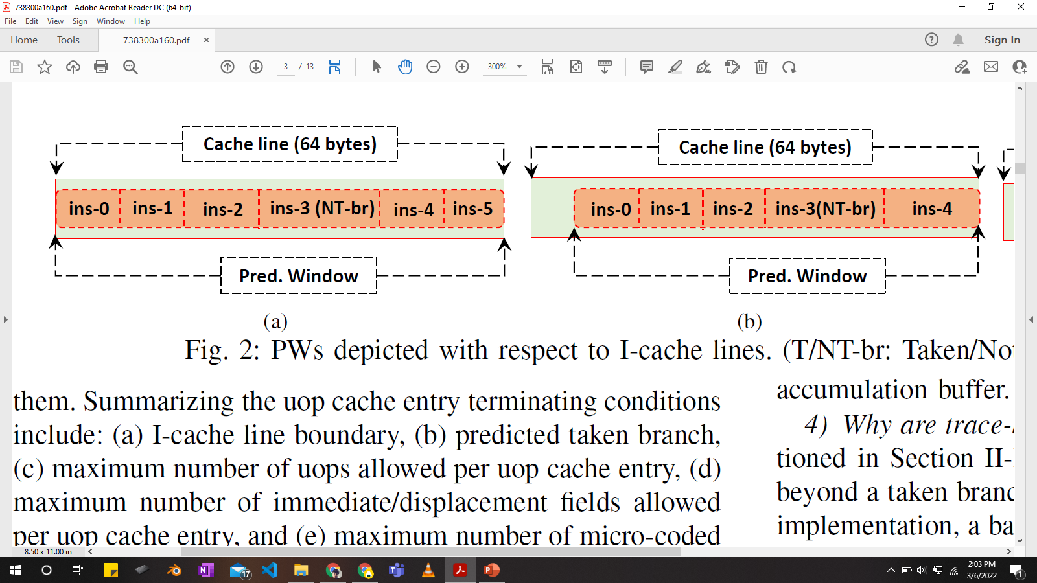
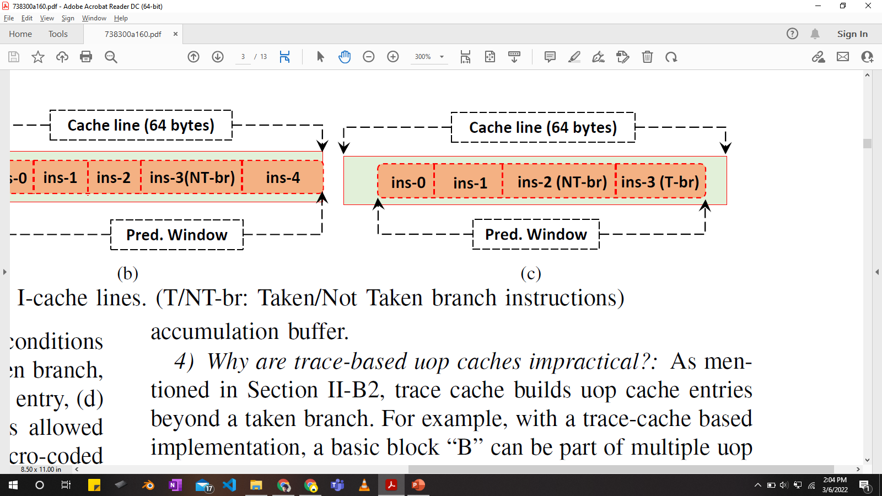
Prediction window(PW)
PW : can start and end anywhere in an I-cache line
Termination conditions
(1) I-cache line boundary (2) Predicted taken branch

Slide 10
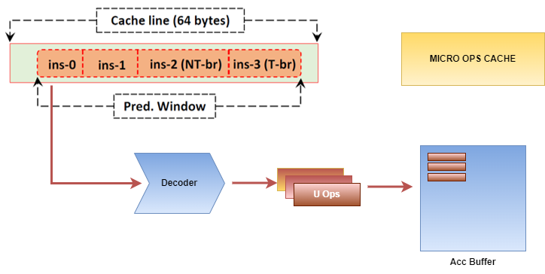
Uop cache entry

Slide 11
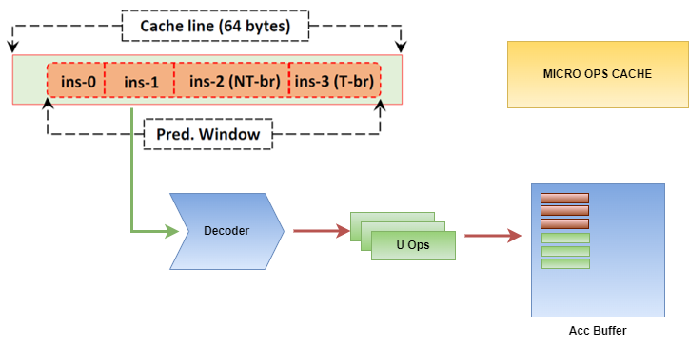
Uop cache entry

Slide 12
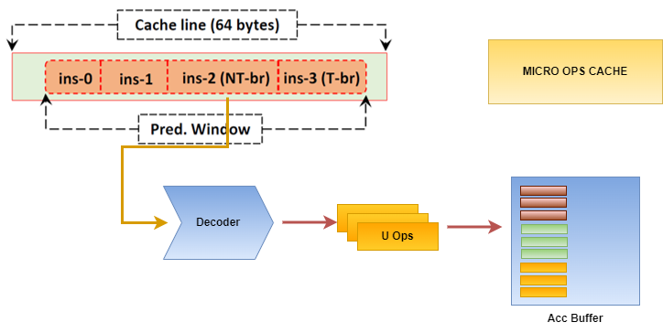
Uop cache entry

Slide 13
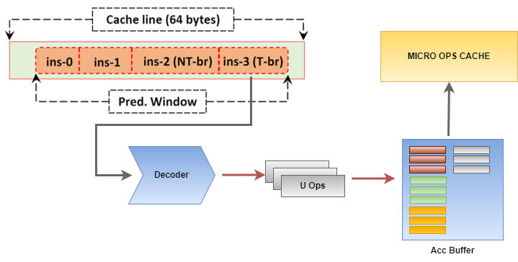
Uop cache entry

Slide 14
Uop cache entry
uop cache line
cache entry
PW termination condition* -> uop cache entry written to uop cache
Uop cache entry: set of uops
Takeaway: uop cache entry may not occupy entire uop cache line

Slide 15
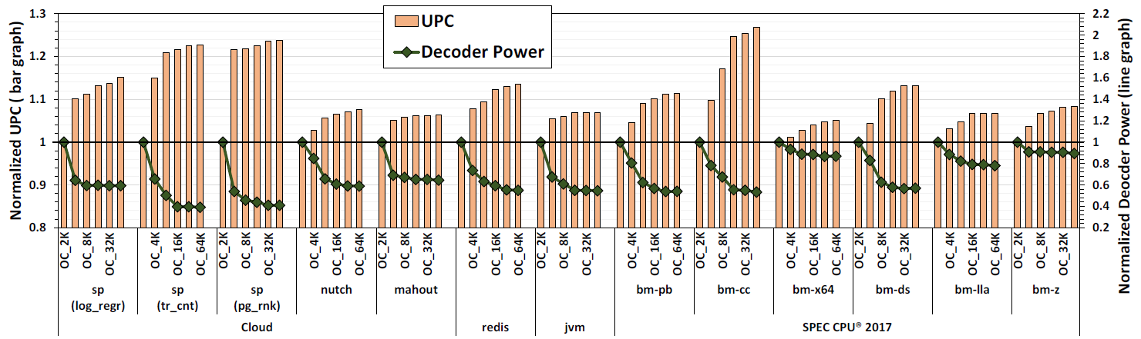
Impact of Uop cache
25%
40%

Slide 16
Impact of Uop cache
Average UPC improvement: 11.2 % (64K uop cache)
Average reduction decoder power consumption: 39.2 %

Slide 17


What next?
Throw money: Increase Uop cache size
Optimize the current Uop cache design

Slide 18
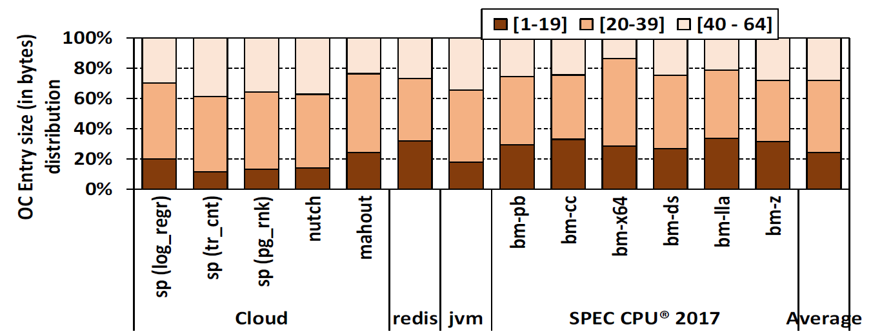
Motivation: Inefficient uop cache
*cache line size: 64B
72% of Uop cache lines are highly fragmented
Main reason: termination conditions

Slide 19
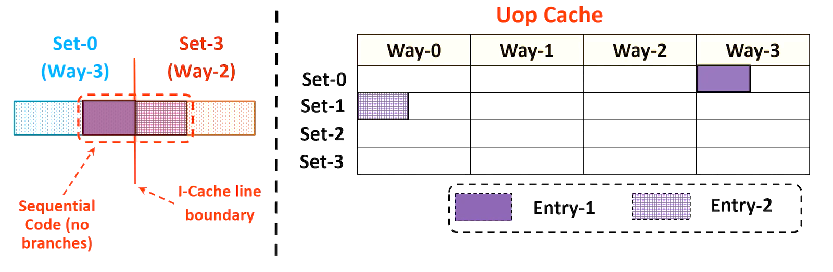
Fragmentation source: I-cache line boundary
Termination condition leads to smaller uop cache entries
Low uop cache utilization

Slide 20
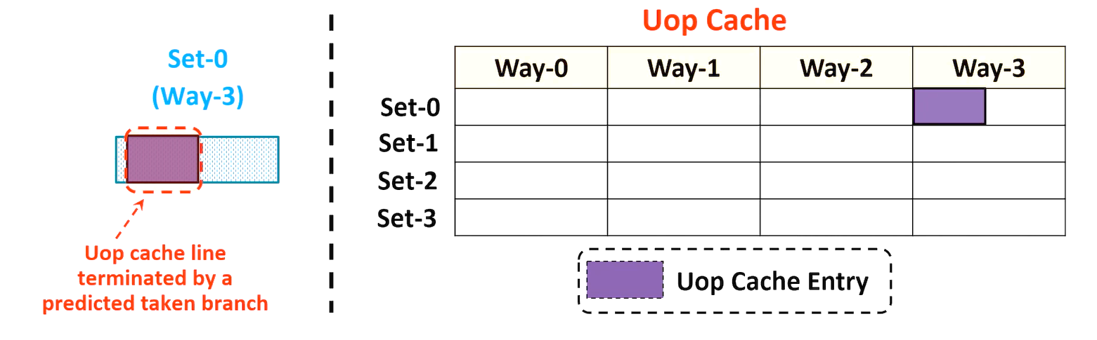
Fragmentation source: Predicted taken branch
Termination condition leads to smaller uop cache entries
Low uop cache utilization

Slide 21
Fragmentation source: other conditions
Max. no. of immediate/displacement values per cache line
Max. no. of microcoded instructions per cache line

Slide 22
Solutions proposed
Two solutions to reduce fragmentation:
CLASP - I-cache line boundary
Compaction - other termination cond.
Replacement aware Compaction
Prediction window aware Compaction
Forced-PW aware compaction

Slide 23
Pause
Any questions?

Slide 24
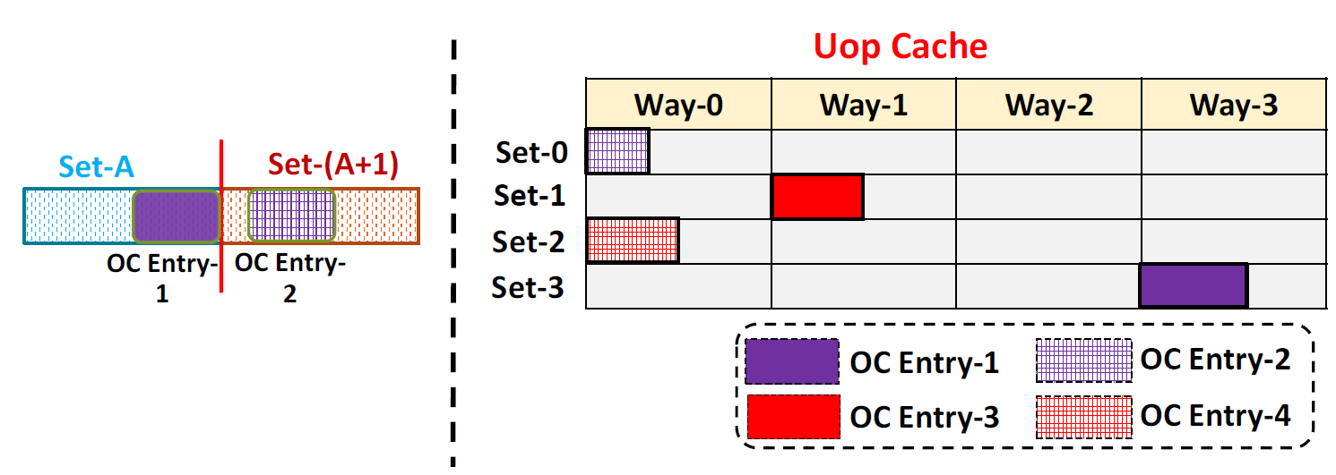
Cache line boundary agnostic Uop (CLASP)
Sequential
code
(no branch)
I-cache line
boundary
Termination condition 1: I-cache line boundary

Slide 25
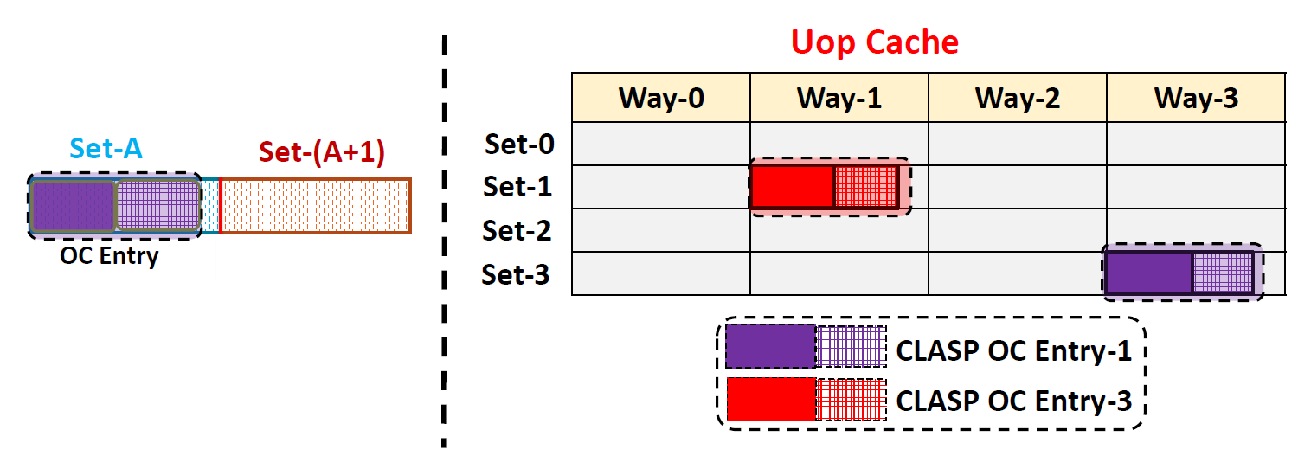
Cache line boundary agnostic Uop (CLASP)
Merged
Relaxes I-cache line boundary termination condition
Only in case of sequential code
Doubles dispatch bandwidth

Slide 26
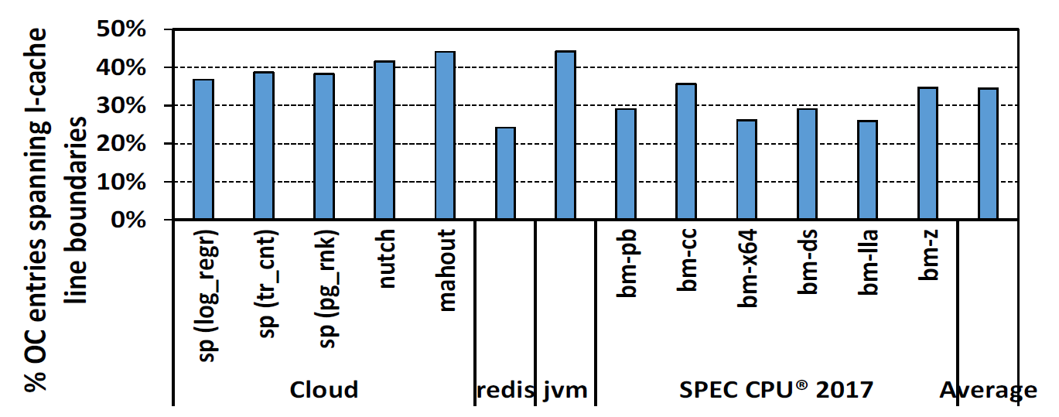
Cache line boundary agnostic Uop (CLASP)
On average 35% of Uop cache entries are merged by CLASP

Slide 27
Fragmentation source: Predicted taken branch
Termination condition 2

Slide 28
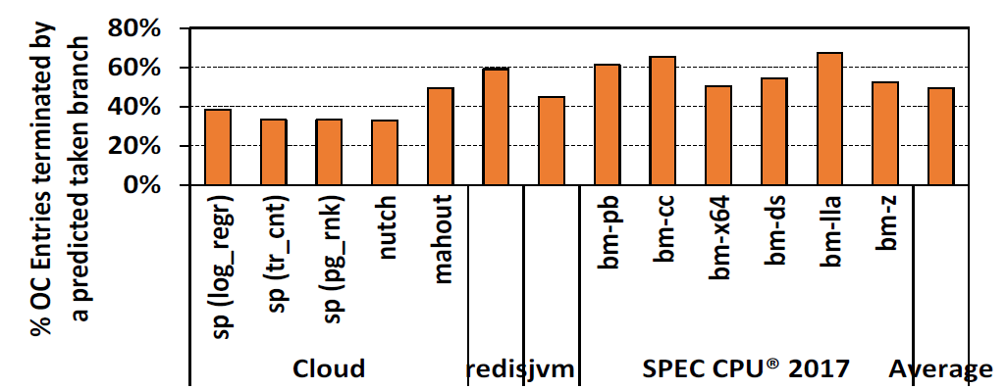
Fragmentation source: Predicted taken branch
On average 49% of Uop cache entries terminated by predicted taken branches

Slide 29
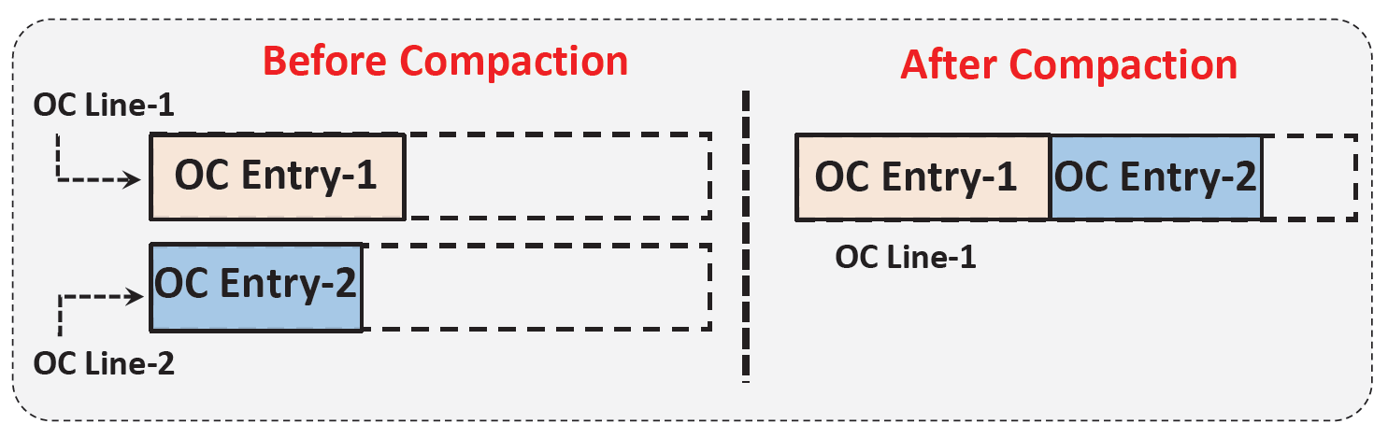
Compaction
Compacts Uop cache entries in a single cache line
Target termination conditions other than I-cache line boundary
Entries are not merged together to a single entry unlike CLASP
Dispatch bandwidth remains same unlike CLASP

Slide 30

Compaction: Challenge
Which Uop cache entries to compact together?

Slide 31
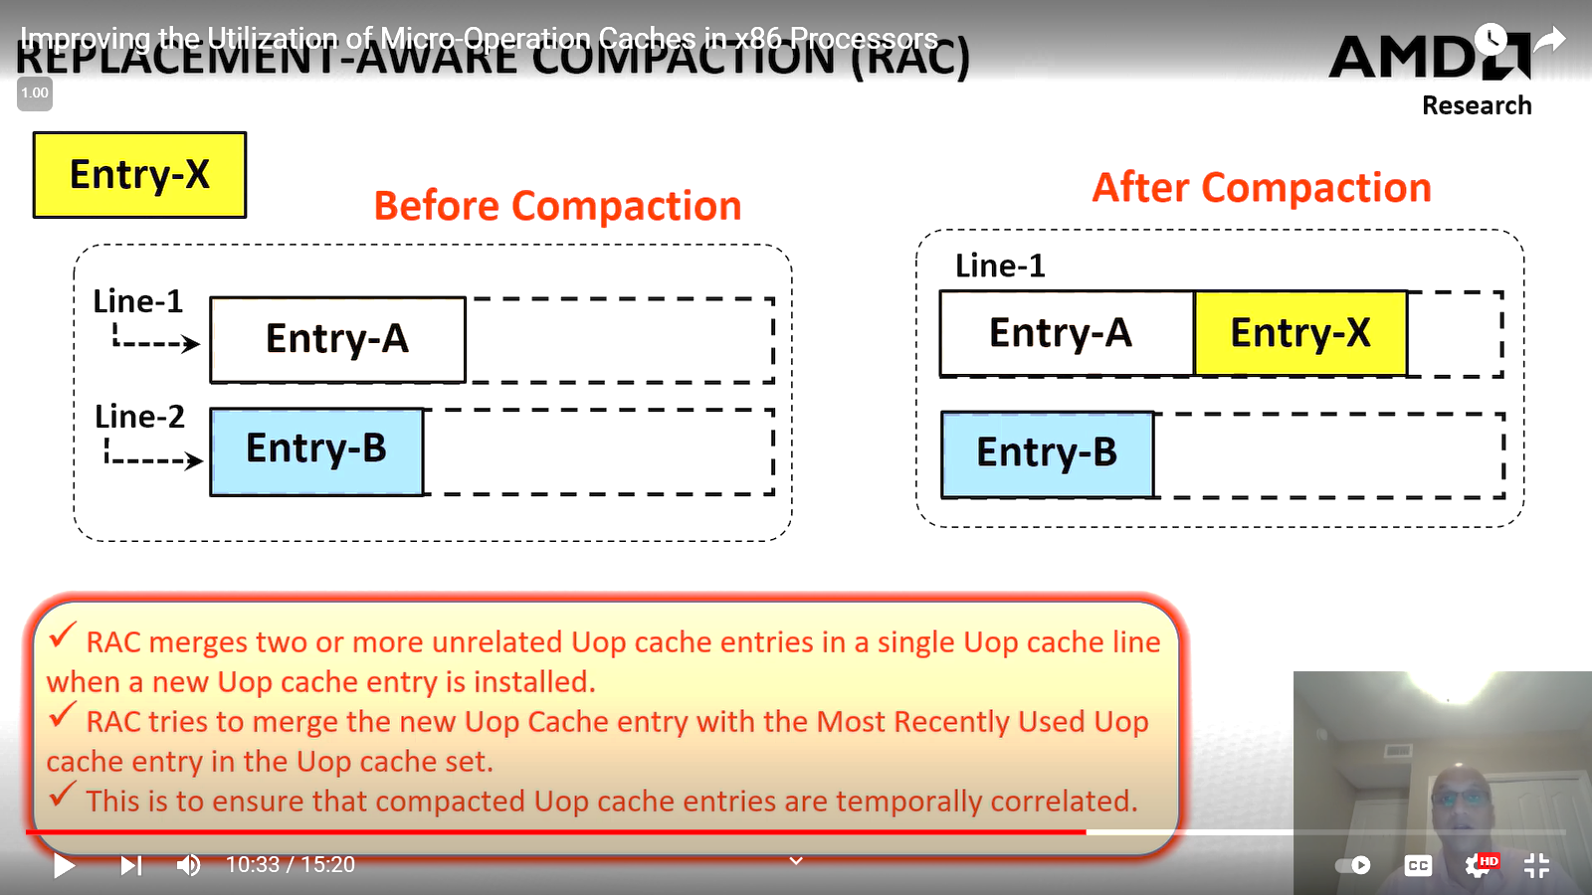
Replacement aware compaction(RAC)
Note: compaction at the time of Uop cache fill
MRU
Compacts new Uop cache entry with the MRU line in cache set
Ensures Uop cache entries are temporally correlated

Slide 32
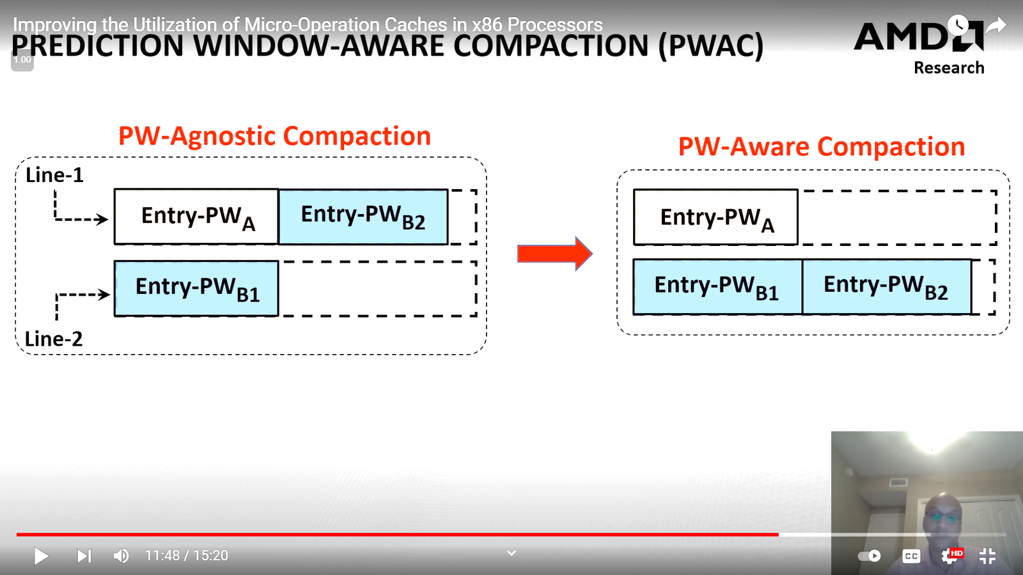
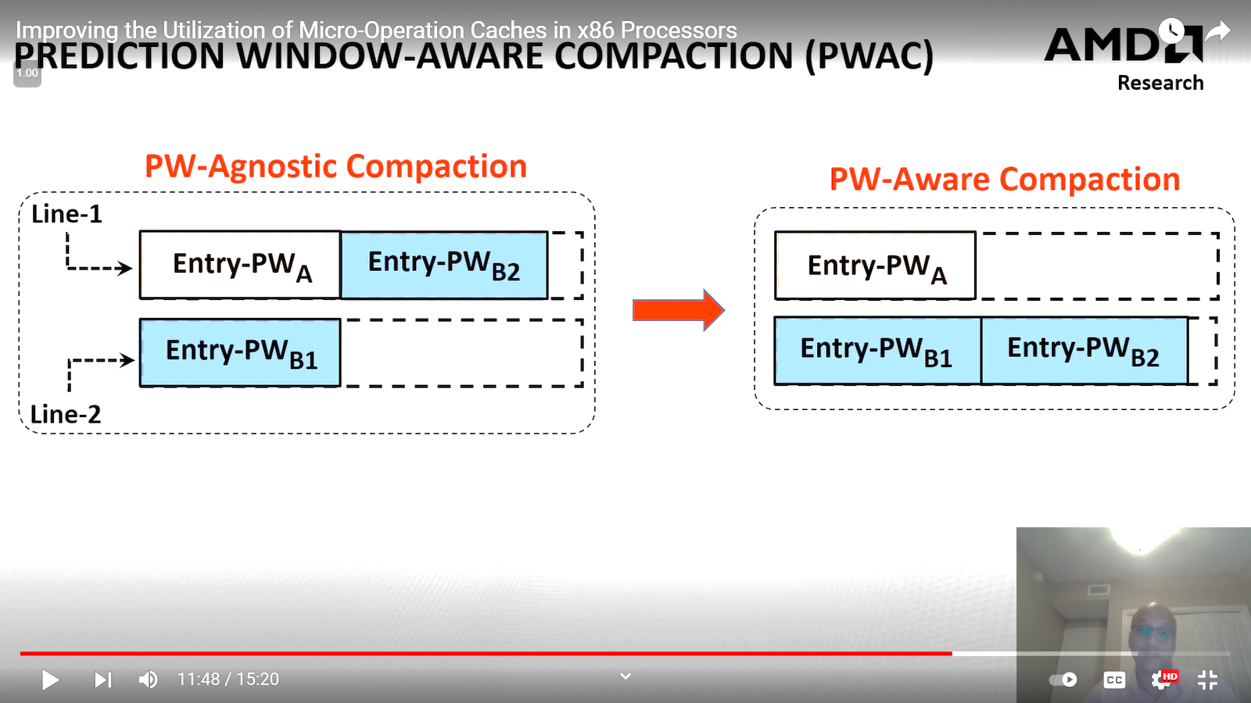
PW aware compaction (PWAC)
MRU
*Overrides RAC
Attempts to compact new Uop cache entry with entries from same Prediction window

Slide 33
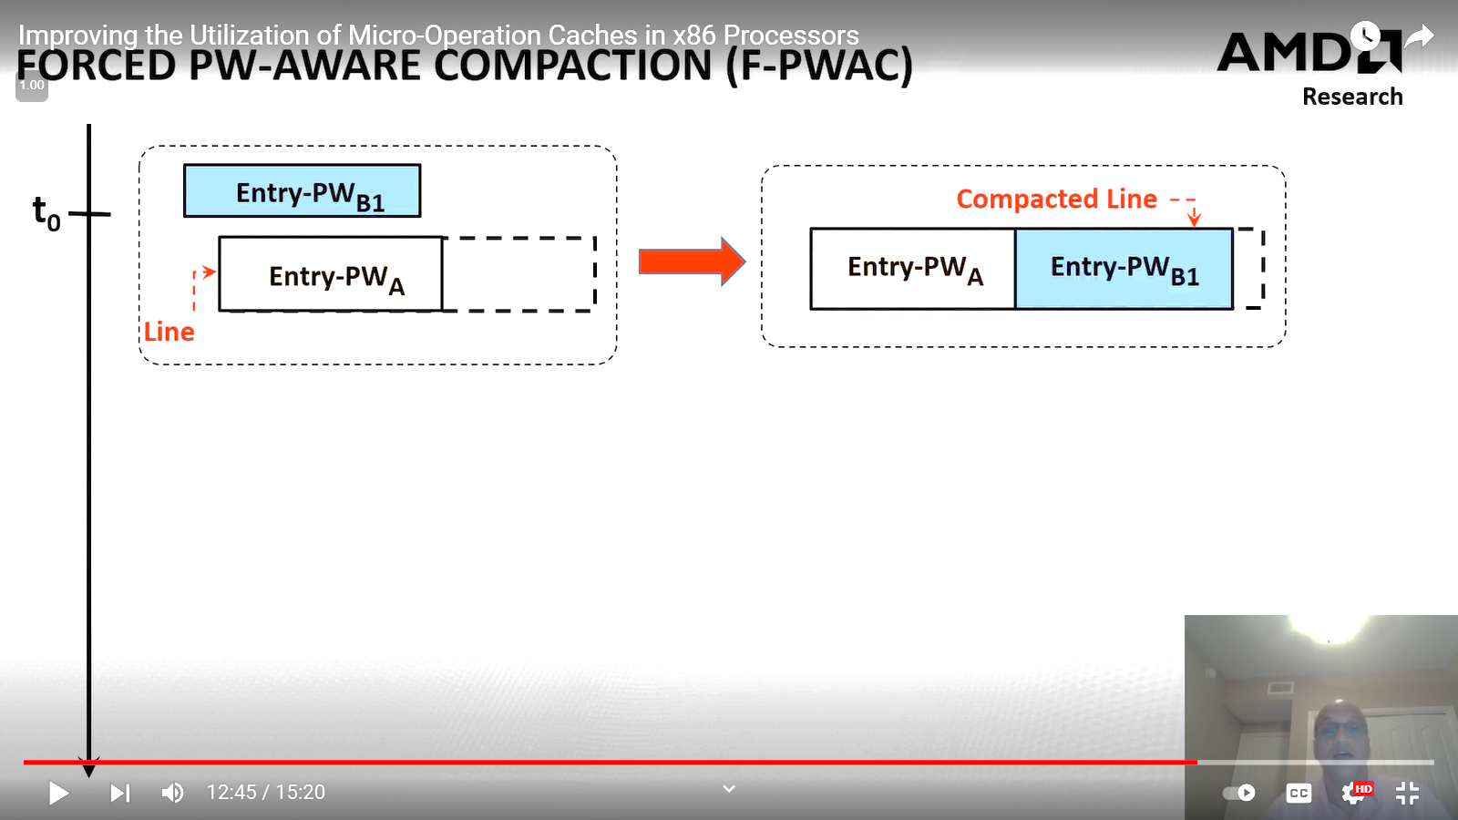
Forced-PWAC
T₀

Slide 34
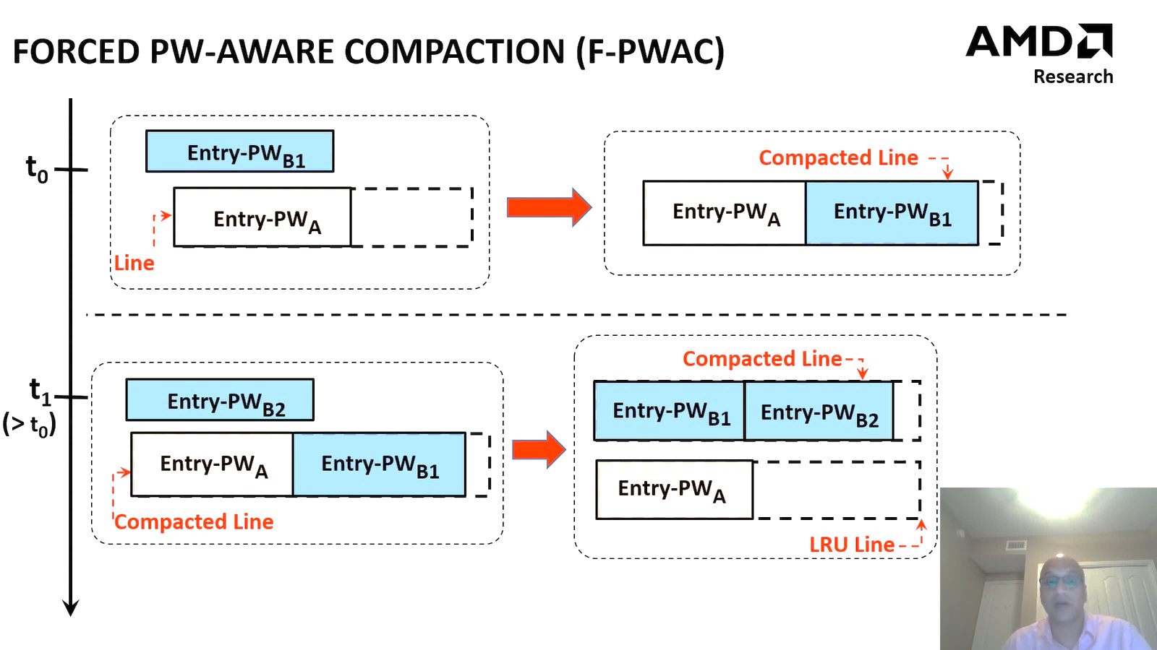
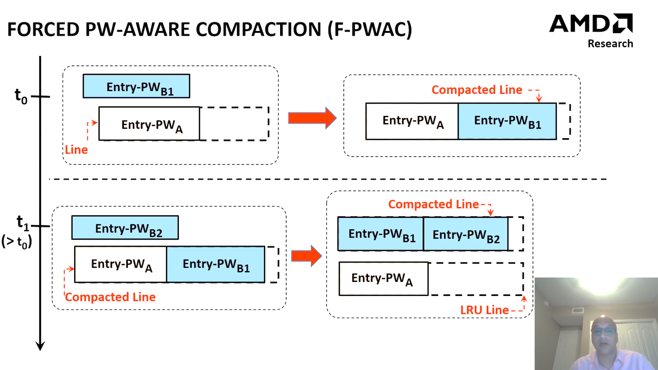
Forced-PWAC
T₀
T₁
Forces compaction of entries from same PW

Slide 35
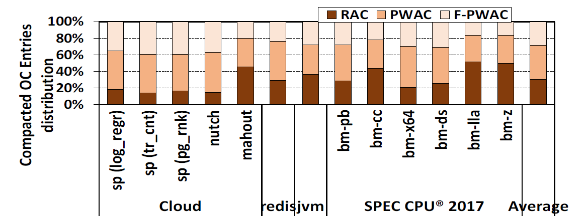
Compaction technique distribution
Note: all 3 compaction techniques work simultaneously
Usage priority: PWAC > F-PWAC > RAC
Almost equal distribution

Slide 36
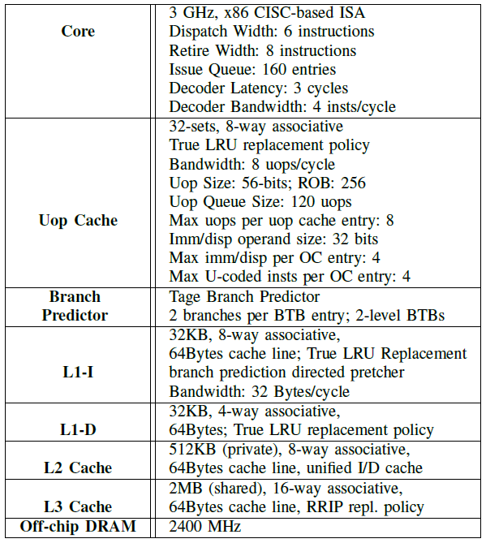
Evaluation setup
Baseline Uop cache fits 2K uops

Slide 37
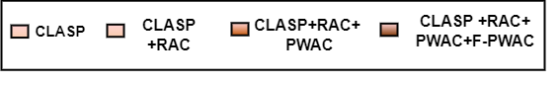
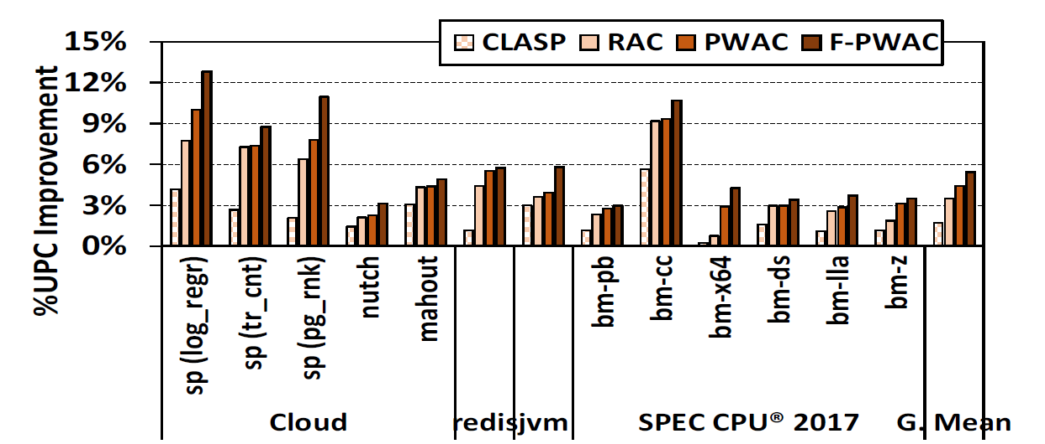
Performance improvement
5.3%
Performance improvement with CLASP + compaction: 5.3 %

Slide 38
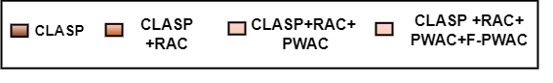
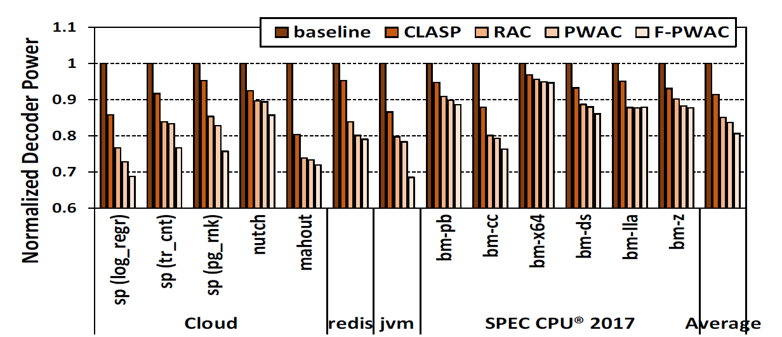
Power reduction
19.4%
Decoder power reduction with CLASP + compaction: 19.4 %

Slide 39
Conclusion
Uop cache is highly fragmented due to terminating conditions.
CLASP reduces fragmentation by relaxing I-cache line boundary termination condition
Compaction reduces fragmentation by joining possibly unrelated uop cache entries.

Slide 40
Thank You Any Questions?

Slide 41
Points to discuss
Why is PWAC prioritized over RAC compaction technique?
F-PWAC incurs an additional read and write
Compaction increases uop cache lookup latency

